Slide 1
Long Short Term Memory (LSTM)
Jayaraj P B
Associate Professor
Department of Computer Science and Engineering
National Institute of Technology Calicut, Kerala, India

Slide 2


Slide 3
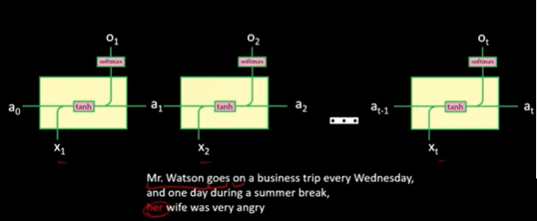
RNN will fail to identify this mistake
If fails to remember the words that appeared long before

Slide 4
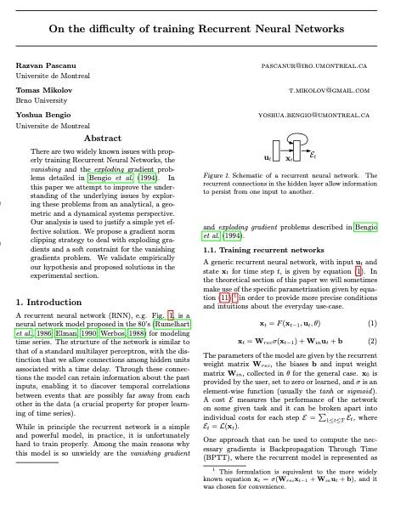
Pascanu, Razvan & Mikolov, Tomas & Bengio, Y.. (2012). On the difficulty of training Recurrent Neural Networks. 30th International Conference on Machine Learning, ICML 2013.
There are two widely known issues with properly training Recurrent Neural Networks, the vanishing and the exploding gradient problems detailed in Bengio et al. (1994).
Given the BPTT equations rewritten such that the gradients are represented in sum-of-products form - transport the error “in time“ from step t back to step k.
“Long term and short term contributions, where long term refers to components for which k << t and short term to everything else”.

Slide 5
Vanishing Gradient
The vanishing gradient problem occurs when the gradients used to update network weights during backpropagation become extremely small.
Why It Happens
During Backpropagation Through Time (BPTT), gradient terms are repeatedly multiplied by the same weight matrices across time steps.
If weight magnitudes are less than 1, repeated multiplication makes gradients exponentially smaller.
Activation functions like sigmoid and tanh exacerbate this since their derivatives are below 1.
Notes:
During Loss computation,
We do derivative (Loss) / derivative (Weights) which will be a matrix if the singular value(which is sqrt of the Eigen value corresponding to the Largest Eigen Vector) if that is small i.e < 1 and we keep multiplying the same thing over several timesteps then the derivative will be smaller and smaller leading to diminishing or vanishing gradients.

Slide 6
Exploding Gradient Problem
As introduced in Bengio et al. (1994), the exploding gradients problem refers to the large increase in the norm of the gradient during training. Such events are caused by the explosion of the long term components, which can grow exponentially more then short term ones.

Slide 7
Shortcomings of RNNs
Sometimes, we only need to look at recent information to perform the present task
Case 1: “The clouds are in the sky,” - The gap between the relevant information and the place that it’s needed is small, RNNs can learn to use the past information.
No further context is needed.
Case 2: “I grew up in France… I speak fluent French” - The gap between the relevant information and the point where it is needed becomes very large.
Then, RNNs become unable to learn to connect the information.
Thankfully, LSTMs don’t have this problem!
http://colah.github.io/posts/2015-08-Understanding-LSTMs/

Slide 8
LSTM
LSTM, or Long Short-Term Memory, is a type of recurrent neural network (RNN) to process sequential data by using memory cells and gates to retain information for extended periods.
This structure allows LSTMs to overcome the vanishing gradient problem found in traditional RNNs and is effective for tasks that require understanding long-term dependencies in data.
Common applications include speech recognition, natural language processing, and time-series forecasting

Slide 9
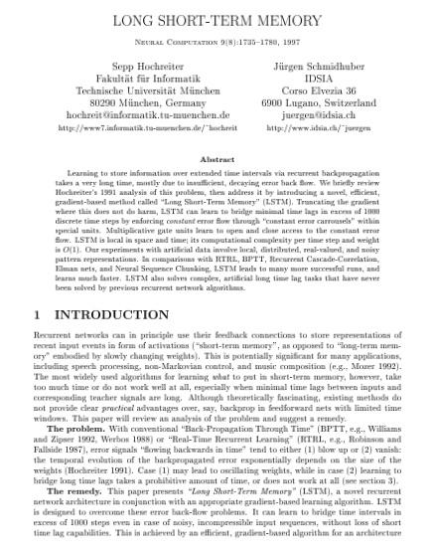
Long Short Term Memory
LSTMs are introduced by Hochreiter & Schmidhuber (1997)

Slide 10
How it works
Memory cells: LSTMs contain a cell state, which acts as a long-term memory or a "conveyor belt" for information. Information can flow along this state with only minor linear interactions, making it easy for it to be preserved unchanged.
Gates: The cell state's flow is regulated by three gates—input, forget, and output—which are composed of a sigmoid neural net layer and a multiplication operation.
* Forget gate: Decides what information to throw away from the cell state.
* Input gate: Decides what new information to store in the cell state.
* Output gate: Decides what to output based on the cell state.

Slide 11
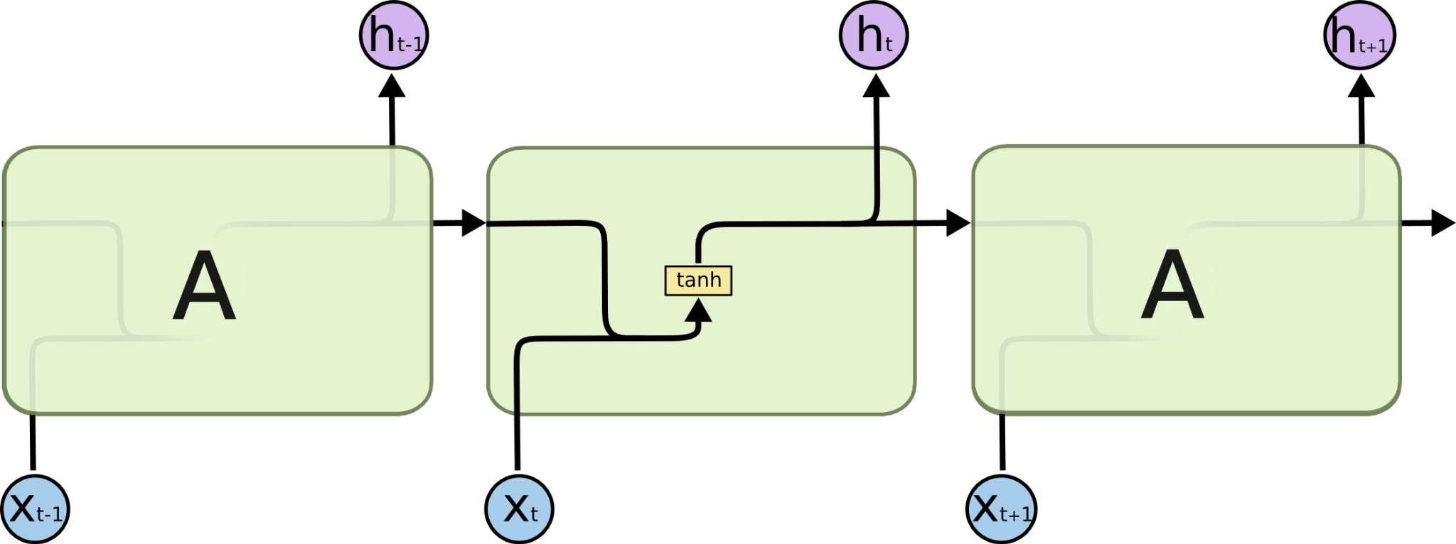
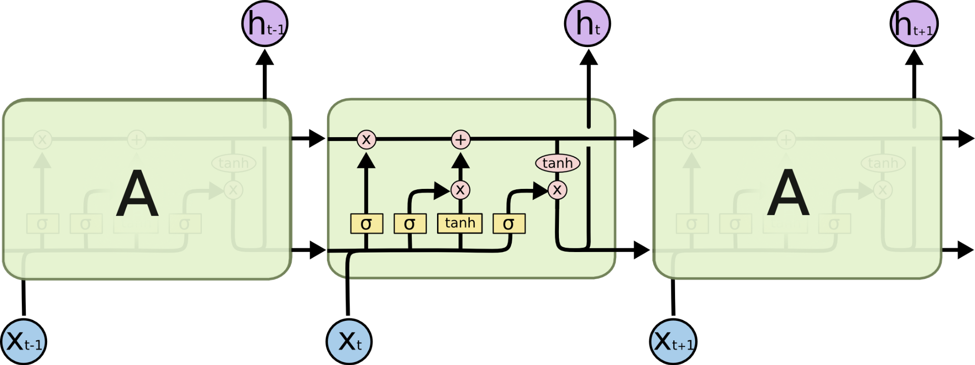
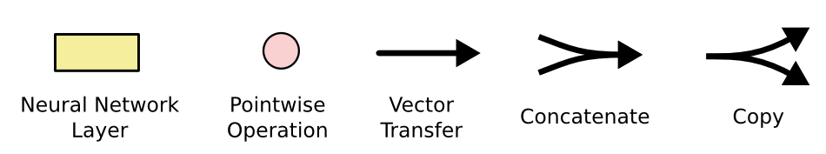
Architectural difference - RNN & LSTM
The repeating module in a standard RNN contains a single layer
The repeating module in an LSTM contains four interacting layers.
http://colah.github.io/posts/2015-08-Understanding-LSTMs/

Slide 12

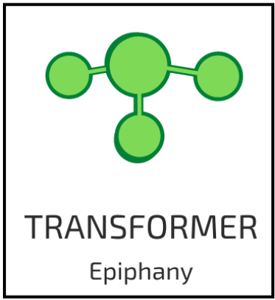

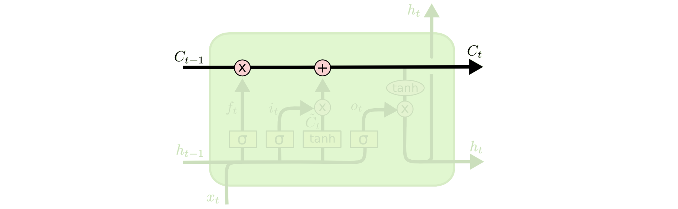
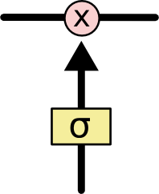
LSTM - Closer view
The key to LSTMs is the cell state, the horizontal line running through the top of the diagram
LSTM has the ability to remove or add information to the cell state, carefully regulated by structures called gates.
Gates are a way to optionally let information through - composed out of a sigmoid neural net layer and a pointwise multiplication operation
The sigmoid layer outputs numbers between zero and one, describing how much of each component should be let through.
A value of zero means “let nothing through,” while a value of one means “let everything through!”.
An LSTM has three of these gates, to protect and control the cell state.
Cell State
Gate
http://colah.github.io/posts/2015-08-Understanding-LSTMs/

Slide 13
LSTM Walk Through
Decide what information we’re going to throw away from the cell state. This decision is made by a sigmoid layer called the “forget gate layer”.
Decide what new information we’re going to store in the cell state.
First, a sigmoid layer called the “input gate layer” decides which values we’ll update.
Next, a tanh layer creates a vector of new candidate values, that could be added to the state. In the next step, we’ll combine these two to create an update to the state.
Update the old cell state, into the new cell state
Finally, decide what we’re going to output
Run a sigmoid layer which decides what parts of the cell state we’re going to output.
Put the cell state through tanh and multiply it by the output of the sigmoid gate, so that we only output the parts we decided to.

Slide 14
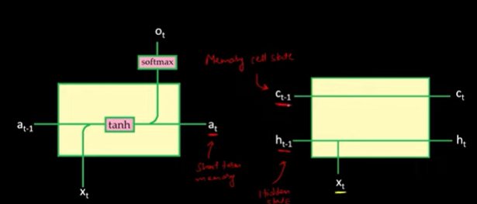
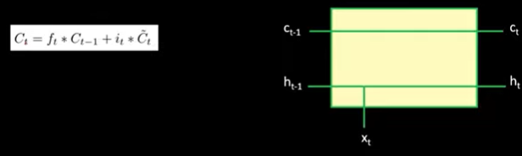
RNN & LSTM Cells

Slide 15
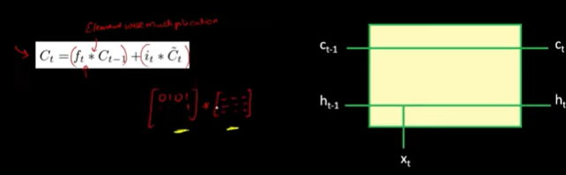
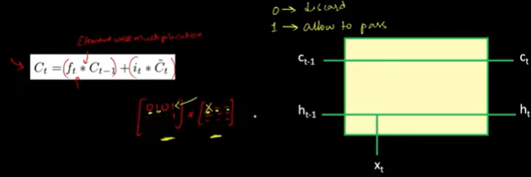

Slide 16
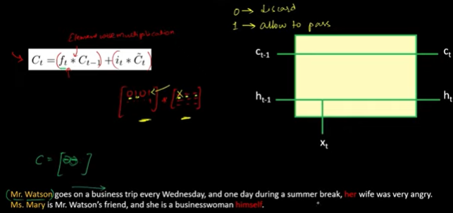
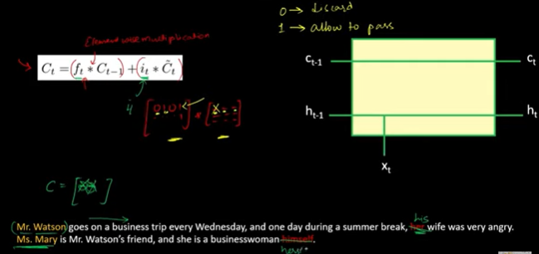

Slide 17
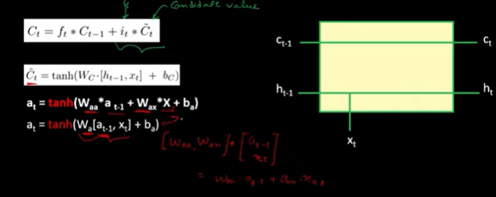
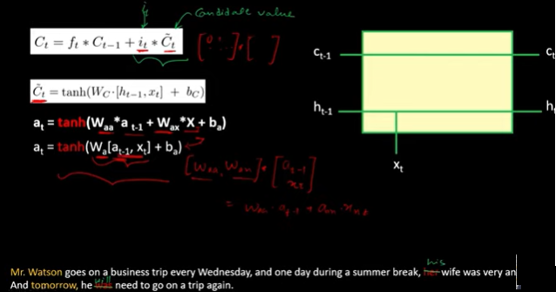

Slide 18
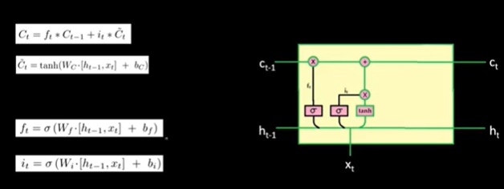

Slide 19
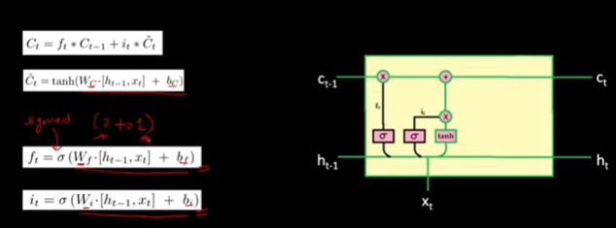

Slide 20
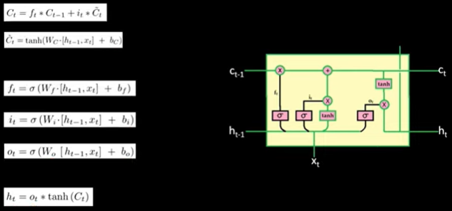

Slide 21
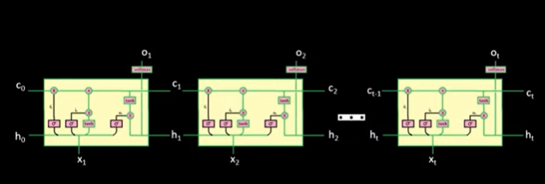

Slide 22
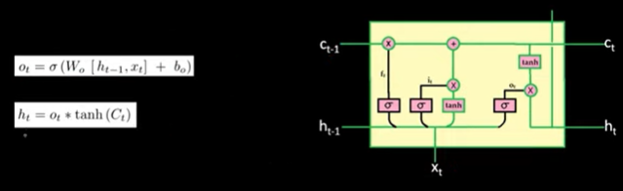

Slide 23
Solving Vanishing /Exploding Gradient problem with LSTM
In the forward propagation, gates control the flow of information to the cell state.
During the backward propagation, gates control the flow of gradients.
So gradients vanish only when they should.

Slide 24
Real world Applications
Time series prediction
Speech recognition
Music composition
Handwriting recognition
Human action recognition
Sign language translation
Time series anomaly detection
So on….

Slide 25
Gradient clipping
Exploding gradient problem is solved by “Gradient Clipping”.
Gradient clipping is a method where the error derivative is changed or clipped to a threshold during backward propagation through the network, and the clipped gradients are used to update the weights.

Slide 26
Thank You !!!

